Slide 1
Statistical Analysis I
Statistical Models, Sampling Distributions, and Basic Inference Procedures

Slide 2
Statistical Models
“All models are wrong ,
but some are more useful than others.” - George Box
One model that has proved “useful” for many years to describe outcomes X_{i}, i = 1, …, n
of random processes is given as
X_{i} = μ + є_{i},
where μ = an expected value or mean value for each X_{i}, and
є_{i} = a random deviation from this mean value for each X_{i}, i = 1, …, n.
What makes the model “statistical” is the use of a distributional model for the random
deviations є_{i}.
Far and away the most commonly applied distributional model is the Normal distribution,
including the assumptions of
1) a mean (expected value) of zero for each of the deviations,
2) a common amount of variation for each of the deviations, and
3) mutual independence among the deviations, denoted as
є_{i} ~ NID(0, σ²), where σ² = Var(є_{i}), i = 1, …, n.

Slide 3
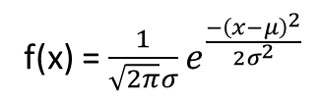
Normal Probability Density Function
f(x) = $\frac{1}{\sqrt{2π}σ}e^{\frac{−{\left(x−μ\right)}^{2}}{2σ^{2}}}$
Mean = µ
Standard Deviation = σ
P[a < x < b] = _{a}∫^{b} f(x) dx
Note: As with all distributions, total area under the curve = 1

Slide 4
Standard Normal Distribution
A Standard Normal Distribution is when
the mean µ=0 and
the standard deviation σ=1
Properties of the Standard Normal Distribution
The total area under the curve is equal to 1
The distribution is “bell-shaped”
Symmetrical
Mounded (Unimodal)
Extends infinitely in both directions
Has Mean = 0 and Standard Deviation = 1
The Mean divides the area under the curve in half
0.5 Below the Mean
0.5 Above the Mean
Nearly All the area (99.7% = 0.9970) lies between
a = -3 and
b = +3
The probability of any specific value is Zero (ie, P[x=a] = 0)

Slide 5
Normal Distributions
Any Normal Distribution can be Converted to a Standard Normal Distribution by
- Subtracting its Mean from the Value(s) of Interest, and then
- Dividing this by its Standard Deviation
- This is commonly referred to as generating a “Z-score”
Consider the information that the Heights of Kindergarten children (ie, X) is
Normally distributed with a Mean = 39 inches, and a Standard Deviation = 2 inches
In order to find the Probability an Individual Kindergartener will be between
38 and 40 inches tall, we would convert these values to their Z-scores:
X = 38 => Z = (38-39)/2 = -1/2 and X = 40 => Z = (40-39)/2 = 1/2, and then
Compute the desired probability using the Standard Normal Distribution result
For the P[38 < X < 40] = P[-1/2 < Z < 1/2] = 0.3829
This can be done using a table
OR
By using the following Excel commands:
=NORMSDIST(0.5) – NORMSDIST(-0.5)
R command: pnorm(0.5) – pnorm(-0.5)
OR
No need to convert to z-scores if you use the following Excel commands:
=NORMDIST(40,39,2,TRUE) – NORMDIST(38,39,2,TRUE)
OR
R command: pnorm(40,39,2) – pnorm(38,39,2)

Slide 6
Normal Distributions
Or we could just use an Excel Utility:

Slide 7
Normal Distributions
This Utility can also be used to answer such questions as:
What Height would we only expect 5% of Kindergartners to exceed?
In other words, to find x₀ where P[ X < x₀] = P[ Z < (x₀ – μ)/σ] = 0.95.
Excel command: norm.inv(0.95,39,2)
R Command: qnorm(0.95,39,2)

Slide 8
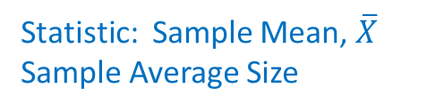
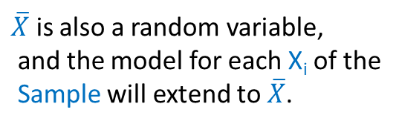

Point Estimates
A sample statistic is used to estimate a population parameter. Recall, what we
generally want to know is a population parameter, but all we have available
is a subset of the population – a sample, from which we can generate sample
statistics.
Suppose we are interested in Knowing the Mean of a Specific Quality Characteristic Being Produced by a Manufacturing Process
Population: All parts being produced
Population
Sample: A few parts selected for
Measurement of the Specific
Quality Characteristic (eg, Size)
Sample
Parameter: Population Mean, µ
Mean Size being produced by
entire process
Statistic: Sample Mean, $\overline{X}$
Sample Average Size
$\overline{X}$ is also a random variable,
and the model for each X_{i} of the
Sample will extend to $\overline{X}$.
Sample Average Size, $\overline{X}$, is Point Estimate of
Production Process Mean Size, µ.

Slide 9
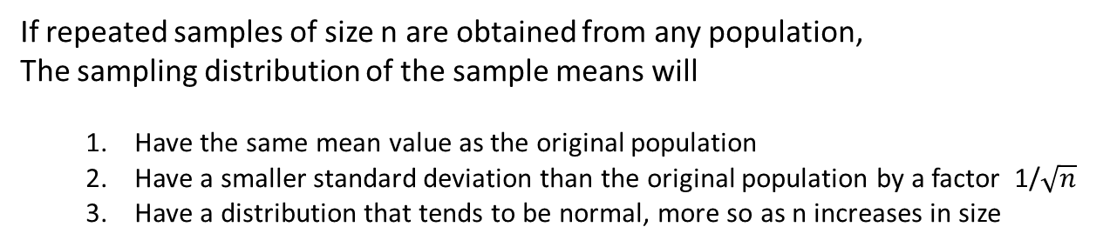
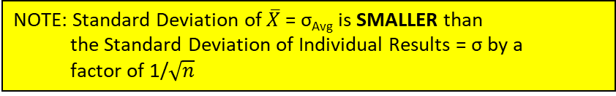
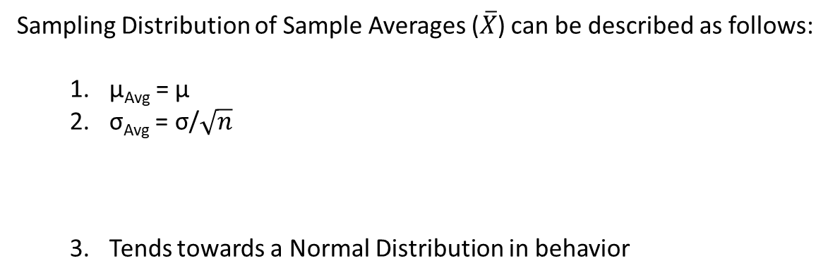
Central Limit Theorem
Most Powerful Theorem in Statistics
If repeated samples of size n are obtained from any population,
The sampling distribution of the sample means will
Have the same mean value as the original population
Have a smaller standard deviation than the original population by a factor 1/$\sqrt{n}$
Have a distribution that tends to be normal, more so as n increases in size
Sampling Distribution of Sample Averages ($\overline{X}$) can be described as follows:
µ_{Avg} = µ
σ_{Avg} = σ/$\sqrt{n}$
Tends towards a Normal Distribution in behavior
NOTE: E[$\overline{X}$] = µ_{Avg} = µ, so $\overline{X}$ unbiased estimator of µ
NOTE: Standard Deviation of $\overline{X}$ = σ_{Avg} is SMALLER than
the Standard Deviation of Individual Results = σ by a
factor of 1/$\sqrt{n}$
NOTE: Distribution is EXACTLY Normal if distribution of Individual Results is Normal. Only need n ~10 for a “mounded” distribution, n > 30 usually sufficient for most other distributions

Slide 10
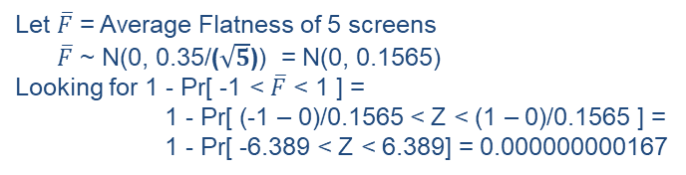
Central Limit Theorem
Example
A common practice in manufacturing is to sample product as produced by the manufacturing process. Often several parts/packages/units are sampled at a given time and evaluated.
Imagine you work for a company that produces touch screen panels for smart phones, and at the end of each shift 5 screens are sampled from the end of the line and measured for flatness.
The specifications for flatness results is 0 ± 1 micron and currently, the process appears to
be running near its target of 0 with a standard deviation of 0.35 microns. In addition, the
flatness results can be reasonably described using a normal distribution.
1) What is the probability that an individual screen will be out-of-spec?
Let F = Flatness Measurement on a single screen
F ~ N(0, 0.35)
Looking for 1 - Pr[ -1 < F < 1 ] =
1 - Pr[ (-1 – 0)/0.35 < Z < (1 – 0)/0.35 ] =
1 - Pr[ -2.857 < Z < 2.857] = 0.0043
2) What is the probability that a sample average of 5 screens will be out-of-spec?
Let $\overline{F}$ = Average Flatness of 5 screens
$\overline{F}$ ~ N(0, 0.35/($\sqrt{5}$)) = N(0, 0.1565)
Looking for 1 - Pr[ -1 < $\overline{F}$ < 1 ] =
1 - Pr[ (-1 – 0)/0.1565 < Z < (1 – 0)/0.1565 ] =
1 - Pr[ -6.389 < Z < 6.389] = 0.000000000167
So what do you think of the practice of releasing
screens for shipment if the sample average is
within specifications?

Slide 11
Point Estimates
A sample proportion, p, is also a sample statistic used to estimate a population parameter. The statistical model involved is not quite the same as the simple mean + error model, but it is still relatively simple: X_{i} = 1 with probability π and X_{i} = 0 with probability (1-π). The parameter π represents the probability of the outcome of interest. [Bernoulli Trials]
Suppose we are interested in Knowing the True Proportion of Orange Reese’s Pieces Being Produced by Hershey
Population: All Reese’s Pieces Being
Produced by Hershey
Population
Sample: A group of Reese’s Pieces
selected at random from a Bag of
Reese’s Pieces (eg, samples of 25)
Sample
Parameter: Population Proportion, π, of
Orange RPs being produced by Hershey
Statistic: Sample Proportion, p
Number of Orange in Sample (X) /
Sample Size (n), so p = X/n
Sample Proportion, p = X/n, is Point Estimate of
Hershey’s Process Proportion, π.

Slide 12
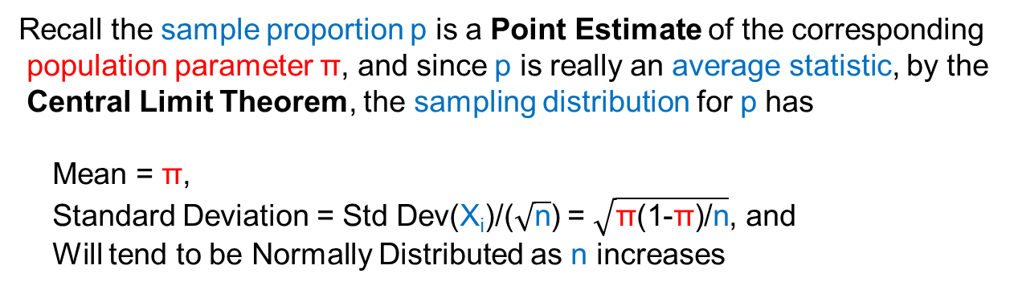
Sample Proportion
A sample proportion is really a sample average in disguise
If we imagine each sample point as a Bernoulli trial, and
Let the random variable
{
X_{i} = 1 if that trial is a “success”
0 if that trial is a “failure”
Then the average of the X_{i}s = $\overline{X}$ = [Sum_{i=1 to n}(X_{i})]/n = p,
Since [Sum_{i=1 to n}(X_{i})] is a count of the number of “successes” in the sample
Recall the sample proportion p is a Point Estimate of the corresponding
population parameter π, and since p is really an average statistic, by the
Central Limit Theorem, the sampling distribution for p has
Mean = π,
Standard Deviation = Std Dev(X_{i})/($\sqrt{\text{n}}$) = $\sqrt{\text{π}\text{(1-}\text{π}\text{)/}\text{n}}$, and
Will tend to be Normally Distributed as n increases
How large does n need to be for distribution to reasonably approximate a normal?
n > 9*max[(1-π)/π, π/(1-π)]
(ie, if π=0.5, then n>9)

Slide 13
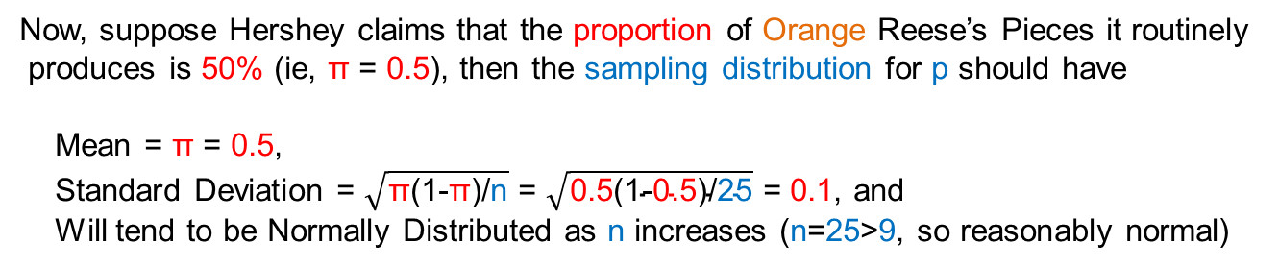
Sample Proportion
Example: Suppose we want to estimate the proportion of Orange Reese’s
Pieces produced by Hershey, call this population parameter: π
The information we have is a sample of n = 25 Reese’s Pieces
If we imagine each Reese’s Piece (ie, sample point) as a Bernoulli trial, and
Let the random variable
{
X_{i} = 1 if that piece is Orange (ie, trial is a “success”)
0 if that piece is not Orange (ie, trial is a “failure”)
Then the [Sum_{i=1 to 25}(X_{i})] = Count of Orange Reese’s Pieces in the sample,
Say this Count = 10, then p = 10/25 = 0.4 (ie, [Sum_{i=1 to 25}(X_{i})]/n)
Now, suppose Hershey claims that the proportion of Orange Reese’s Pieces it routinely
produces is 50% (ie, π = 0.5), then the sampling distribution for p should have
Mean = π = 0.5,
Standard Deviation = $\sqrt{\text{π}\text{(1-}\text{π}\text{)/}\text{n}}$ = $\sqrt{\text{0.5}\text{(1-}\text{0.5}\text{)/}\text{25}}$ = 0.1, and
Will tend to be Normally Distributed as n increases (n=25>9, so reasonably normal)
So … is the proportion p = 0.4 in our sample of 25 unusual?
Can we use the information above to help answer this question?

Slide 14
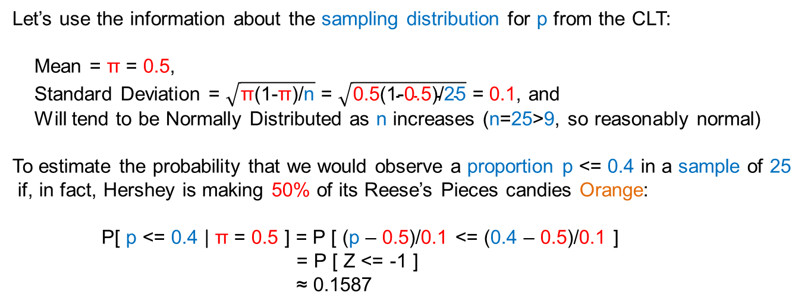
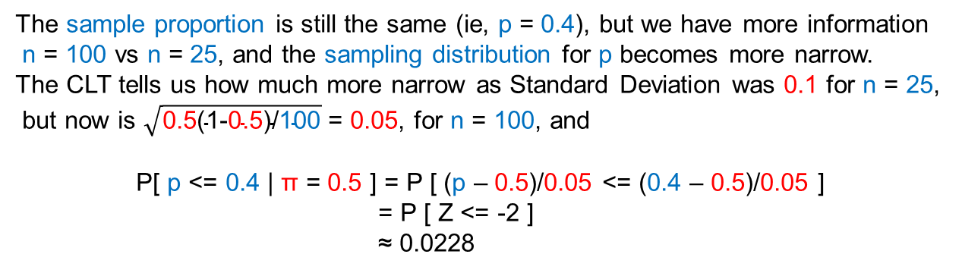
Sample Proportion
Let’s use the information about the sampling distribution for p from the CLT:
Mean = π = 0.5,
Standard Deviation = $\sqrt{\text{π}\text{(1-}\text{π}\text{)/}\text{n}}$ = $\sqrt{\text{0.5}\text{(1-}\text{0.5}\text{)/}\text{25}}$ = 0.1, and
Will tend to be Normally Distributed as n increases (n=25>9, so reasonably normal)
To estimate the probability that we would observe a proportion p <= 0.4 in a sample of 25
if, in fact, Hershey is making 50% of its Reese’s Pieces candies Orange:
P[ p <= 0.4 | π = 0.5 ] = P [ (p – 0.5)/0.1 <= (0.4 – 0.5)/0.1 ]
= P [ Z <= -1 ]
≈ 0.1587
So … is the proportion p = 0.4 in our sample of 25 unusual? What do you think?
What if our sample size was 100 and we only observed 40 Orange RPs (ie, p still 0.4)?
The sample proportion is still the same (ie, p = 0.4), but we have more information
n = 100 vs n = 25, and the sampling distribution for p becomes more narrow.
The CLT tells us how much more narrow as Standard Deviation was 0.1 for n = 25,
but now is $\sqrt{\text{0.5}\text{(1-}\text{0.5}\text{)/}\text{100}}$ = 0.05, for n = 100, and
P[ p <= 0.4 | π = 0.5 ] = P [ (p – 0.5)/0.05 <= (0.4 – 0.5)/0.05 ]
= P [ Z <= -2 ]
≈ 0.0228
So … now what do you think?

Slide 15
Elements of a Test of Hypothesis
Suppose we work for a pharmaceutical company, and have a new drug
for the treatment heart murmurs.
The competition has an already established drug for this on the market
that is known to work successfully with 65% of patients to which it is
administered.
We want to know if the success rate for our new drug is higher than the
65% success rate for the currently available competitive offering.
The hypothesis we would like to validate is that the success rate for
our drug (call this π) is greater than 65% (ie, 0.65).
This is the RESEARCH HYPOTHESIS
(also often called the ALTERNATIVE HYPOTHESIS)
It can be expressed in abbreviated form as: H₁: π > 0.65
The RESEARCH HYPTOHESIS is the one we would like to validate.

Slide 16
Elements of a Test of Hypothesis
In order to establish the validity of the RESEARCH HYPOTHESIS,
we need take an indirect approach and assume the opposite is true.
We assume that the success rate of the new drug, π, is 65% (or less).
This is the NULL HYPOTHESIS
(also often called the NULL MODEL)
It can be expressed in abbreviated form as: H₀: π = 0.65
(NOTE: Being less than 65% is implied from the form of the RESEARCH HYPOTHESIS)
The NULL HYPTOHESIS is the OPPOSITE of the one we would like to validate.
The actual test is focused on evaluating if the NULL HYPOTHESIS is valid, or
reasonable, hoping for sufficient evidence in the test to contradict this,
and then conclude that the RESEARCH HYPOTHESIS must be valid instead.

Slide 17
Elements of a Test of Hypothesis
So now we have two Hypotheses:
H₀: π = 0.65
(NULL HYPOTHESIS)
H₁: π > 0.65
(RESEARCH HYPOTHESIS)
We obtain test information (ie, data from a sample of some nature).
In the drug example, this would ideally be treatment results of patients
administered the new drug.
We then evaluate the test (ie, sample) information in hopes that it will provide
“sufficient evidence” to contradict (ie, REJECT) the NULL HYPOTHESIS and
conclude the RESEARCH HYPOTHESIS is indeed true.
However, this sample data might not provide such evidence, and we will be
left to conclude that the NULL HYPOTHESIS could still be viable (ie, FAIL TO REJECT) and fail to determine that the RESEARCH HYPOTHESIS is true.

Slide 18
Elements of a Test of Hypothesis
H₀: π = 0.65
(NULL
HYPOTHESIS)
REJECT
FAIL TO REJECT
ACCEPT
OR
ACCEPT
FAIL TO ACCEPT
REJECT
H₁: π > 0.65
(RESEARCH
HYPOTHESIS)
So … NEVER ACCEPT the NULL HYPOTHESIS, Only REJECT or FAIL TO REJECT
and NEVER REJECT the RESEARCH HYPOTHESIS, Only ACCEPT or FAIL TO ACCEPT

Slide 19
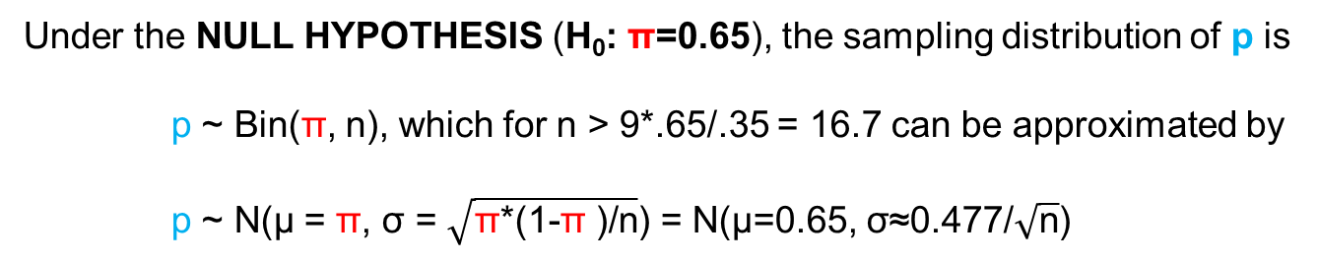
Elements of a Test of Hypothesis
Once a NULL MODEL has been established, then we need a way to use
the sample data to evaluate (ie, test) it.
This is the role of the TEST STATISTIC, which is generally a function of the
sample statistic corresponding to the population parameter of interest.
The TEST STATISTIC has a sampling distribution that can be specified under
the NULL MODEL, this is called the NULL DISTRIBUTION.
For the drug example, the TEST STATISTIC will be the sample proportion
p = number of patients tested where drug is success (n_{S}) / total number tested (n)
Under the NULL HYPOTHESIS (H₀: π=0.65), the sampling distribution of p is
p ~ Bin(π, n), which for n > 9*.65/.35 = 16.7 can be approximated by
p ~ N(μ = π, σ = $\sqrt{\text{π}\text{*(}\text{1}\text{-}\text{π} \text{)/}\text{n}}$) = N(μ=0.65, σ≈0.477/$\sqrt{\text{n}}$)
Suppose n = 50, then p ~ N(μ=0.65, σ≈0.067)
The NULL DISTRBUTION is the sampling distribution of the TEST STATISTIC
under the NULL MODEL (ie, assuming the NULL HYPOTHESIS is true).

Slide 20
Elements of a Test of Hypothesis
Once we have a TEST STATISTIC and its NULL DISTRIBUTION, then
we need a DECISION RULE to determine the validity of the NULL MODEL.
In any decision, we run a risk of making an incorrect choice.
It is no different in testing hypotheses.
 | NULL MODEL is Actually …
Based on Sample TEST STATISTIC … | True | False
REJECT NULL MODEL
FAIL TO REJECT NULL MODEL
Type I Error
P[Type I Error] = α
α = Significance Level
Determines Critical Region
for the TEST STATISTIC
Correct
Correct
Type II Error
P[Type II Error] = β
1- β = Power
Function of Δ Between
NULL MODEL & Actual
The DECISION RULE is established by choosing a Significance Level = α
(ie, P[Type I Error] = risk of incorrectly rejecting the NULL HYPOTHESIS)

Slide 21
Elements of a Test of Hypothesis
For our drug example, if we set the significance level α = 0.05, then
given the NULL DISTRIBUTION of our TEST STATISTIC, we would
define our DECISION RULE as any p > p₀ where
P[ p > p₀ | π = 0.65, n = 50] = 0.05 (ie, α)
Since the NULL DISTRIBUTION
of p is its Sampling Distribution
Given π = 0.65 & n = 50 is
p ~ N(µ = 0.65, σ ≈ 0.067),
p₀ = 0.761 (ie, 1.645*0.067)
α=0.05
So … DECISION RULE is
REJECT H₀: π=0.65 if p > 0.761
p₀=0.761

Slide 22
Elements of a Test of Hypothesis
The final elements are a DECISION and a CONCLUSION.
Observed Successful Results | TEST STATISTIC | DECISION | CONCLUSION
n_{S} = 40 | p = 0.80 | REJECT H₀ at Significance Level = 0.05 | New Drug has success rate higher than competitor
n_{S} = 35 | p = 0.70 | FAIL TO REJECT H₀ at Significance Level = 0.05 | Insufficient Evidence to conclude success rate for New Drug is higher than competitor
Not Large
Enough to
Fall in
Critical/REJECT
Region
Large Enough
to Fall in
Critical/REJECT
Region

Slide 23
Elements of a Test of Hypothesis
Observed Significance Level = p-Value
If we observe p = 0.8, then
P[p > 0.8 | π = 0.65, n = 50] ≈ 0.0131
is the observed significance level, and
is known as the p-Value for this test.
A p-Value < Significance Level = α
indicates that H₀ will be REJECTed.
p-Value =
0.0131
If we observe p = 0.7, then
P[p > 0.7 | π = 0.65, n = 50] ≈ 0.2293
is the observed significance level, and
is known as the p-Value for this test.
A p-Value > Significance Level = α
indicates that we will FAIL TO REJECT H₀
p-Value =
0.2293

Slide 24
Types of Research Hypotheses
For Significance Level α = 0.10
Right Tail Research Hypothesis: H₁: π > π₀
Rejection Region all in Right Tail
Left Tail Research Hypothesis: H₁: π < π₀
Rejection Region all in Left Tail
α=0.10
α=0.10
Two-Tail Research Hypothesis: H₁: π ≠ π₀
Rejection Region Split into Both Tails
α=0.05
α=0.05

Slide 25
Type I and Type II Errors
As we seek smaller Type I Error rates,
We necessarily increase Type II Error rates
(and vice versa).
So … we need to assess the relative
consequences of making each type
of error, and choose the Significance
Level for the test accordingly.
β
α
Drug Example:
Type I Error – Determining Better
when Really Not Better
Type II Error – Failing to Recognize
Better when Really is Better
µ₀
µ₁
Can reduce risk of Type II Error by
Increasing Risk of Type I Error
A rule-of-thumb approach:
Type II Error more Severe
- Set α from 0.05 to 0.10
Type I Error more Severe
- Set α from 0 to 0.05
~Same Consequences
- Use α ≈ 0.05
α
β
µ₀
µ₁

Slide 26
Confidence Intervals
In introducing hypothesis testing, the question of interest was whether or not
a newly developed drug for heart murmurs performed better than the competitor’s
currently available offering.
Recall that there were 50 patients tested with the new drug, and if 40 responded
positively, then we would have a sample proportion p = 0.8.
This was greater than the critical value of 0.76, so we Rejected H₀ (our new drug no
better than the competitor’s 65% success rate) and concluded that our drug is better
than the competitor’s drug.
There is still an unanswered question here. The test suggests it is better, but how
much better is it?
Is the answer simply 15% better? Do we simply take the observed sample
proportion 0.80 and subtract the 0.65 success rate of the competitive offering?
This is certainly a reasonable response, as the sample statistic here does provide
our best point estimate of the population parameter we want to advertise, but
there is a problem
P[π_{New} = p = 0.8] = 0

Slide 27
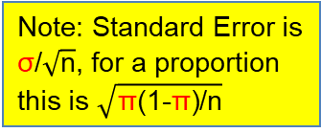
Interval Estimates
However, perhaps we can find an Interval that has a positive probability of
including the Population Parameter we want to know.
Recall: A proportion is just a
mean (average) in disguise
eg, P[ Sample Average – Δ(ξ) < Population Mean < Sample Average + Δ(ξ)] = ξ
where Δ(ξ) > 0 and 0 < ξ < 1
Well … we know that
P[ z(α/2) < Z < z(1-α/2)] = 1-α
and that
Z = (Sample Average – Population Mean) / Standard Error
α/2
α/2
1 - α
z(α/2)
z(1-α/2)
Note: Standard Error is
σ/$\sqrt{\text{n}}$, for a proportion
this is $\sqrt{\text{π}\text{(1-}\text{π}\text{)/}\text{n}}$
P[ z(α/2) < (Sample Average – Population Mean) / Standard Error < z(1-α/2)] = 1 – α
P[ z(α/2) * Standard Error < Sample Average – Population Mean < z(1-α/2) * Standard Error] = 1 – α
P[z(α/2)*Std Error – Sample Average < - Population Mean < z(1-α/2)*Std Error – Sample Average] = 1 – α
P[Sample Average – z(1-α/2)*Std Error < Population Mean < Sample Average – z(α/2)*Std Error] = 1 - α
Population Mean between
Sample Average ± z(1-α/2)*Standard Error
with Probability 1-α

Slide 28

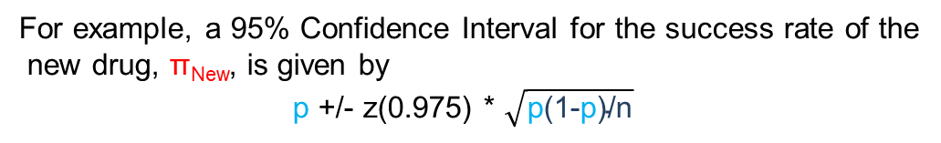
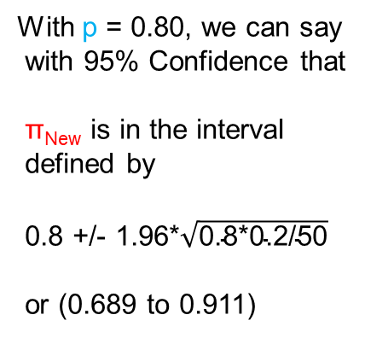
Confidence Intervals
Basic format of Confidence Intervals:
Best Point Estimate ± M(Confidence) * Standard Deviation of Point Estimate
where M(Confidence) is a Multiplier based on the Desired Level of
Confidence that the Interval Contains the True Value of the respective
Population Parameter of interest
For example, a 95% Confidence Interval for the success rate of the
new drug, π_{New}, is given by
p +/- z(0.975) * $\sqrt{\text{p}\text{(1-}\text{p}\text{)/}\text{n}}$
With p = 0.80, we can say
with 95% Confidence that
π_{New} is in the interval
defined by
0.8 +/- 1.96*$\sqrt{\text{0.8*0.2/50}}$
or (0.689 to 0.911)
z(0.025) = -z(0.975)
= -1.96
z(0.975) = 1.96
95%
Between
So, with 95% Confidence,
the success rate for the new
Drug is between ~69% and ~91%

Slide 29
Confidence Intervals
Concept: 95 of 100 95% Confidence Intervals will
contain the True Population Parameter
Suppose that success rate for new drug, π_{New} = 0.75, then
if we had 20 samples, and constructed 20 95% Confidence
Intervals, we would expect 19 of the 20 to include 0.75.
0.98
0.91
0.83
0.75
0.67
0.59
0.51
p
Population
Proportion
π_{New} = 0.75

Slide 30
Confidence Intervals = Hypothesis Tests
A Test of H₀: π = π₀ (or µ = µ₀) at a Significance Level of α
Is Equivalent to
A 1-α% Confidence Interval
If the Interval Does Not Contains π₀ (or µ₀), then Reject H₀
Otherwise, Conclude Insufficient Evidence to Reject H₀
In the example, π₀ = 0.65 is below the 95% Confidence Interval (0.689 to 0.911);
Hence, we would Reject H₀: π = 0.65 and Conclude that H₁: π > 0.65 is True,
at the 0.05 Level of Significance.

Slide 31
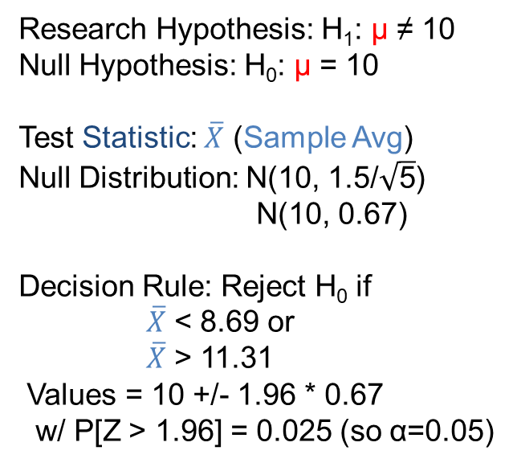
Inference on µ
σ Known
Suppose we have responsibility for managing the gold plating step in the production of specific electronic connector.
The process is routinely sampled with 5 connectors being evaluated for plating thickness.
It is important to keep the plating process on target since too little gold compromises functionality and too much gold significantly increases manufacturing costs.
The process target is 10 mils and the process has a known standard deviation, σ = 1.5 mil.
At each sampling opportunity, we need to decide if process is on-target or not.
Thickness results are normally distributed.
Research Hypothesis: H₁: µ ≠ 10
Null Hypothesis: H₀: µ = 10
Test Statistic: $\overline{X}$ (Sample Avg)
Null Distribution: N(10, 1.5/$\sqrt{\text{5}}$)
N(10, 0.67)
Decision Rule: Reject H₀ if
$\overline{X}$ < 8.69 or
$\overline{X}$ > 11.31
Values = 10 +/- 1.96 * 0.67
w/ P[Z > 1.96] = 0.025 (so α=0.05)

Slide 32


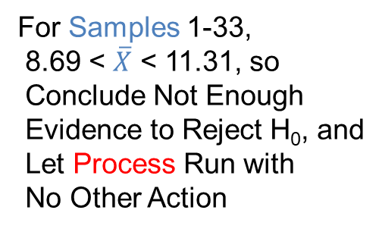
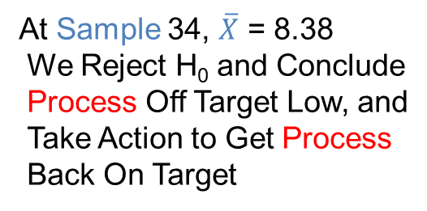
Confidence Intervals for µ
σ Known
Recall the gold plating process example, where with each sample we essentially
perform a test of the Null Hypothesis (H₀: µ = 10) (ie, a test of whether or not the
process is on target).
For Samples 1-33,
8.69 < $\overline{X}$ < 11.31, so
Conclude Not Enough
Evidence to Reject H₀, and
Let Process Run with
No Other Action
At Sample 34, $\overline{X}$ = 8.38
We Reject H₀ and Conclude
Process Off Target Low, and
Take Action to Get Process
Back On Target
At Sample 34, a 95% Confidence Interval for the Current Process Mean would be
8.38 +/- 1.96*0.67 = (7.09 to 9.69)
Note that the interval does not include the Target = 10, Confidence Intervals for
the previous 33 Samples will include Target = 10.
Point Estimate
= $\overline{X}$
Standard Error = σ/$\sqrt{\text{n}}$ = 1.5/$\sqrt{\text{5}}$
Multiplier = z(0.975)

Slide 33
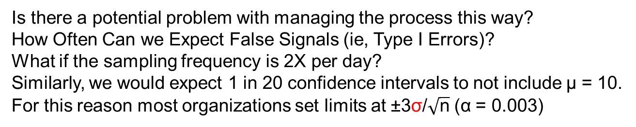
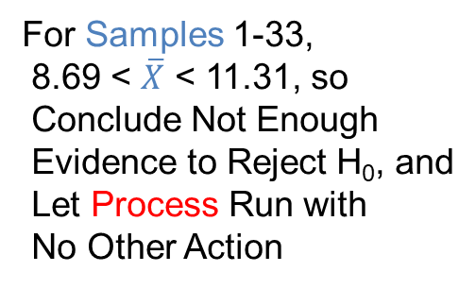
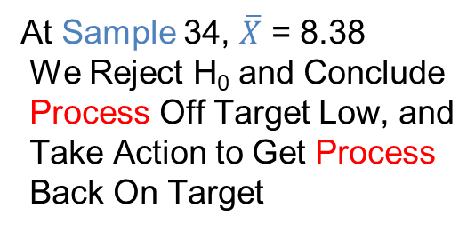
Inference on µ
σ Known
With each sample we essentially perform a test of the Null Hypothesis (H₀: µ = 10)
(ie, a test of whether or not the process is on target).
For Samples 1-33,
8.69 < $\overline{X}$ < 11.31, so
Conclude Not Enough
Evidence to Reject H₀, and
Let Process Run with
No Other Action
At Sample 34, $\overline{X}$ = 8.38
We Reject H₀ and Conclude
Process Off Target Low, and
Take Action to Get Process
Back On Target
Is there a potential problem with managing the process this way?
How Often Can we Expect False Signals (ie, Type I Errors)?
What if the sampling frequency is 2X per day?
Similarly, we would expect 1 in 20 confidence intervals to not include μ = 10.
For this reason most organizations set limits at ±3σ/$\sqrt{\text{n}}$ (α = 0.003)
α = 0.05, so 1 in 20
Expect a False Signal once every 10 days

Slide 34
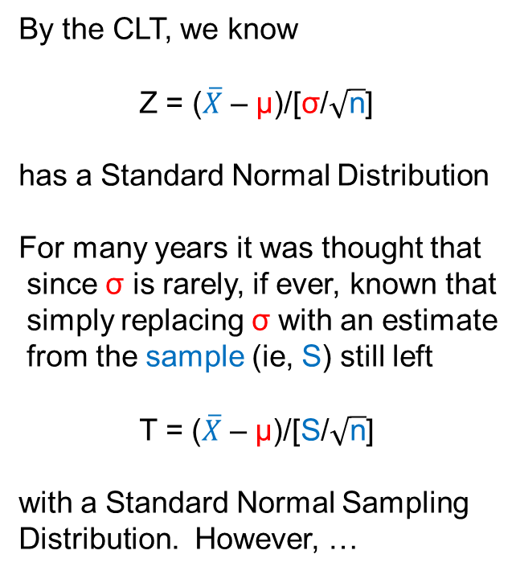
Student’s t Distribution
By the CLT, we know
Z = ($\overline{X}$ – μ)/[σ/$\sqrt{\text{n}}$]
has a Standard Normal Distribution
For many years it was thought that
since σ is rarely, if ever, known that
simply replacing σ with an estimate
from the sample (ie, S) still left
T = ($\overline{X}$ – μ)/[S/$\sqrt{\text{n}}$]
with a Standard Normal Sampling
Distribution. However, …
About 100 years ago William Gosset
working at Guiness discovered that for
Smaller sample sizes, the sampling
distribution of T had heavier tails than
would be expected for a Standard
Normal distribution. He published this
work as “Student”; hence, for T we have

Slide 35
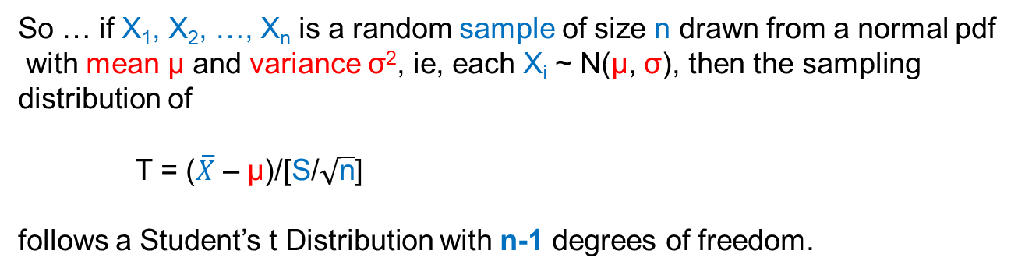
Student’s t Distribution
So … if X₁, X₂, …, X_{n} is a random sample of size n drawn from a normal pdf
with mean μ and variance σ², ie, each X_{i} ~ N(μ, σ), then the sampling
distribution of
T = ($\overline{X}$ – μ)/[S/$\sqrt{\text{n}}$]
follows a Student’s t Distribution with n-1 degrees of freedom.
While the Standard Normal is only one distribution, Student’s t is actually
a family of distributions, and the members are identified by their degrees of
freedom – for most problems we will have this will be the sample size minus
one (ie, n-1).
As the degrees of freedom increase (as the sample size increases), the
Student’s t Distribution becomes increasingly close to a Standard Normal
Distribution. For n ~100 or more, the distributions are virtually identical.

Slide 36
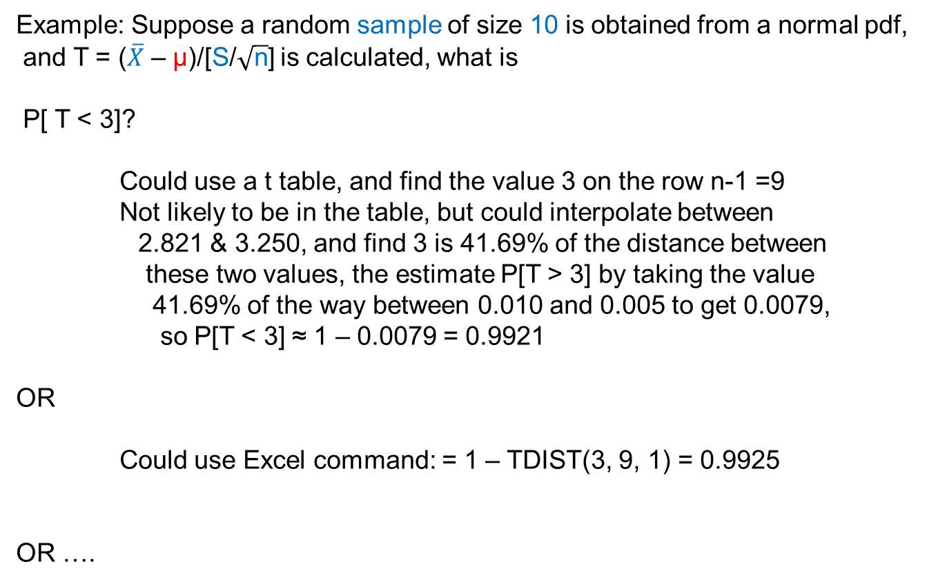
Student’s t Distribution
Example: Suppose a random sample of size 10 is obtained from a normal pdf,
and T = ($\overline{X}$ – μ)/[S/$\sqrt{\text{n}}$] is calculated, what is
P[ T < 3]?
Could use a t table, and find the value 3 on the row n-1 =9
Not likely to be in the table, but could interpolate between
2.821 & 3.250, and find 3 is 41.69% of the distance between
these two values, the estimate P[T > 3] by taking the value
41.69% of the way between 0.010 and 0.005 to get 0.0079,
so P[T < 3] ≈ 1 – 0.0079 = 0.9921
OR
Could use Excel command: = 1 – TDIST(3, 9, 1) = 0.9925
OR ….
Degrees of Freedom
(ie, n – 1 = 10 – 1 = 9)
R command: pt(3, 9)
Value
Tails

Slide 37
Student’s t Distribution
Could use Excel utility:

Slide 38
Student’s t Distribution
Example: Find the value t₀ such that P[ -t₀ < T < t₀ ] = 0.95 (again, for T with 9 df)
Could use a t table and find entry in row n – 1 = 9, and column 0.025 = 2.262
OR
Could use Excel command: TINV(0.05,9) or R command: qt(0.975, 9)
OR
Could use Excel utility:

Slide 39
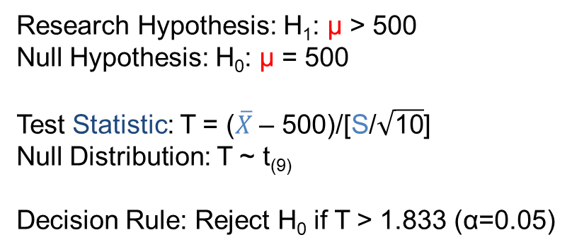
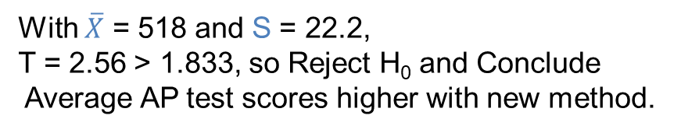
Inference on µ
σ Unknown
In many inference situations, the population standard deviation, σ, is not known.
Consequently, it is necessary to estimate it using the sample data.
Generally, it is estimated with the sample standard deviation, S.
Example: In order to test a new teaching methodology, a school district
randomly selects 10 classes in the district to experience the new approach.
A standardized AP test for the subject is given as the final exam to these classes.
The national average score on this test is 500, and scores are normally distributed.
Data we have is the average AP test result for each of the 10 classes.
Question: Will the mean AP scores for students receiving instruction by
the new method be above the national average?
Research Hypothesis: H₁: µ > 500
Null Hypothesis: H₀: µ = 500
Test Statistic: T = ($\overline{X}$ – 500)/[S/$\sqrt{\text{10}}$]
Null Distribution: T ~ t₍₉₎
Decision Rule: Reject H₀ if T > 1.833 (α=0.05)
With $\overline{X}$ = 518 and S = 22.2,
T = 2.56 > 1.833, so Reject H₀ and Conclude
Average AP test scores higher with new method.

Slide 40
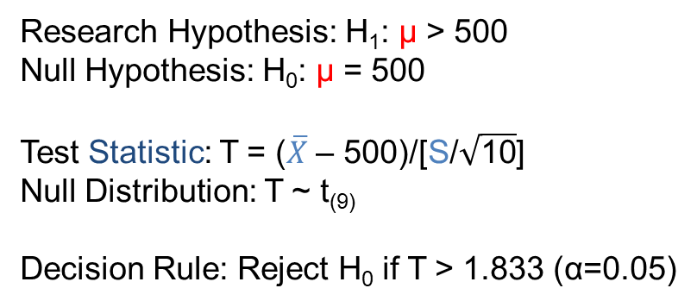


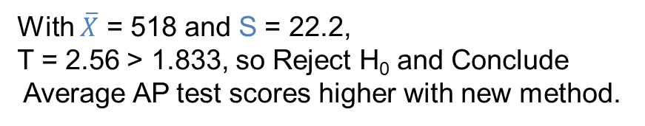
Confidence Intervals for µ
σ Unknown
Example: In order to test a new teaching methodology, a school district
randomly selects 10 classes in the district to experience the new approach.
A standardized AP test for the subject is given as the final exam to these classes.
The national average score on this test is 500, and scores are normally distributed.
Data we have is the average AP test result for each of the 10 classes.
Question: Will the mean AP scores for students receiving instruction by
the new method be above the national average?
Research Hypothesis: H₁: µ > 500
Null Hypothesis: H₀: µ = 500
Test Statistic: T = ($\overline{X}$ – 500)/[S/$\sqrt{\text{10}}$]
Null Distribution: T ~ t₍₉₎
Decision Rule: Reject H₀ if T > 1.833 (α=0.05)
With $\overline{X}$ = 518 and S = 22.2,
T = 2.56 > 1.833, so Reject H₀ and Conclude
Average AP test scores higher with new method.
A 95% Confidence Interval for µ_{New} is given by
518 +/- 2.262*7.02 or (502 to 534)
Estimated Standard Error = S/$\sqrt{\text{n}}$ = 22.2/$\sqrt{\text{10}}$
Point Estimate
= $\overline{X}$
NOTE: Does not include 500
Multiplier = t(9, 0.975)

Slide 41
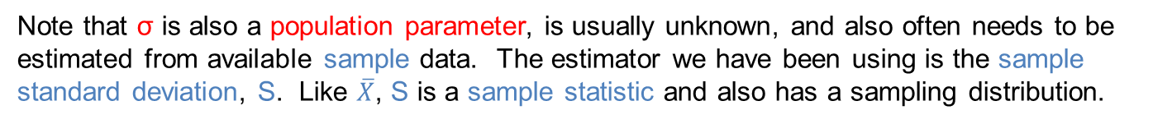
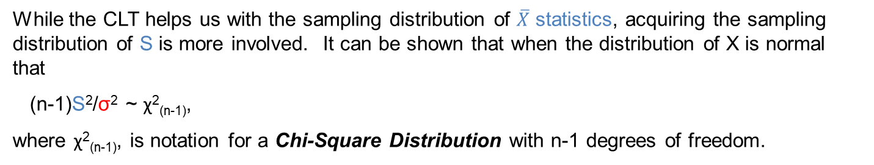
Inference on σ
Note that σ is also a population parameter, is usually unknown, and also often needs to be estimated from available sample data. The estimator we have been using is the sample standard deviation, S. Like $\overline{X}$, S is a sample statistic and also has a sampling distribution.
While the CLT helps us with the sampling distribution of $\overline{X}$ statistics, acquiring the sampling distribution of S is more involved. It can be shown that when the distribution of X is normal that
(n-1)S²/σ² ~ χ²_{(n-1)},
where χ²_{(n-1)}, is notation for a Chi-Square Distribution with n-1 degrees of freedom.
Chi-square distributions do not, in general have the nice symmetrical bell-shape of a normal distribution (although as n-1 gets large, they do tend to take on this shape).
However, this distribution can be utilized to conduct tests of hypotheses for σ, as well as construct confidence intervals for this population parameter.
Chi-square probabilities can be found with the Excel command =CHIDIST(x, n-1) which returns P[>x], or the R command pchisq(x, n-1) = P[<x] and Chi Square percentiles can be found with the Excel command =CHIINV(p, n-1) which returns x | P[>x] = p, or the R command qchisq(p, n-1) returning x | P[<x] = p. In each case, n-1 is the related degrees of freedom.

Slide 42

Inference on σ
In Workshop 1, it was discovered that shift C appeared to have more variable gate width results than the other shifts. If expected gate width standard deviation for the routinely obtained results is 1.5nm, then assessing if the results obtained on shift C are more variable than this is a simple hypothesis test:
Research Hypothesis: H₁: σ > 1.5nm
Null Hypothesis: H₀: σ = 1.5nm
Test Statistic: X² = (n-1)S²/σ²
Null Distribution: χ²_{(n-1)}
Decision Rule: With α = .05,
Reject H₀ if X² > χ²_{(n-1, 1-α)}
Decision: n = 11, S = 4.14, so
X² = 95.23 > χ²_{(10, 0.95)} = 18.31
Conclusion: Variation observed on Shift C is far in excess of the expected amount (p-Value ≈ 5*10⁻¹⁶)
α = 0.05
OK, so variation on C Shift is greater than expected, but by how much?

Slide 43
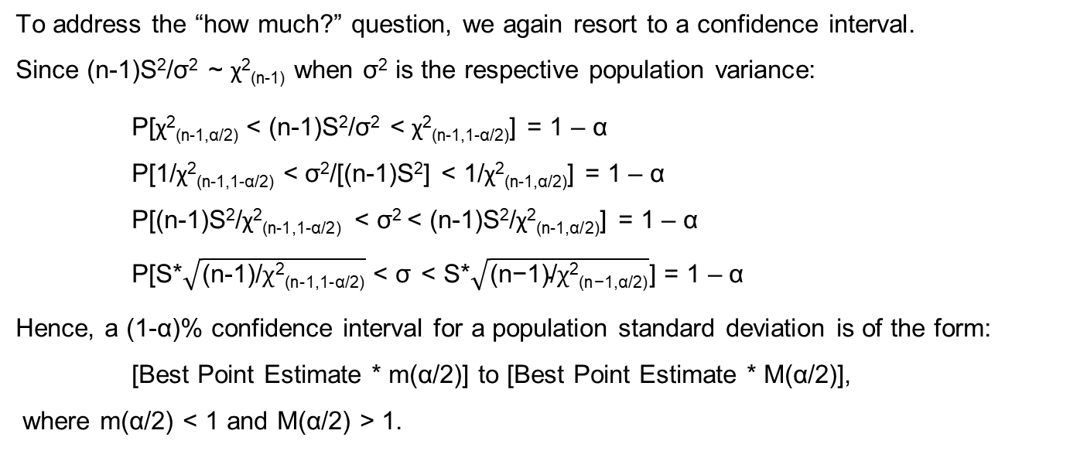
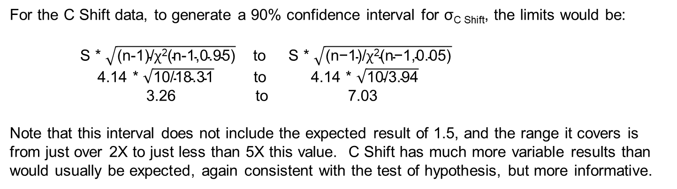
Inference on σ
To address the “how much?” question, we again resort to a confidence interval.
Since (n-1)S²/σ² ~ χ²_{(n-1)} when σ² is the respective population variance:
P[χ²_{(n-1,α/2)} < (n-1)S²/σ² < χ²_{(n-1,1-α/2)}] = 1 – α
P[1/χ²_{(n-1,1-α/2)} < σ²/[(n-1)S²] < 1/χ²_{(n-1,α/2)}] = 1 – α
P[(n-1)S²/χ²_{(n-1,1-α/2)} < σ² < (n-1)S²/χ²_{(n-1,α/2)}] = 1 – α
P[S*$\sqrt{\text{(}\text{n}\text{-1)/}χ\text{2}\text{(}\text{n}\text{-1,1-}\text{α}\text{/2)}}$ < σ < S*$\sqrt{\text{(}\text{n}\text{−1)/}χ\text{2}\text{(}\text{n}\text{−1,}\text{α}\text{/2)}}$] = 1 – α
Hence, a (1-α)% confidence interval for a population standard deviation is of the form:
[Best Point Estimate * m(α/2)] to [Best Point Estimate * M(α/2)],
where m(α/2) < 1 and M(α/2) > 1.
For the C Shift data, to generate a 90% confidence interval for σ_{C Shift}, the limits would be:
S * $\sqrt{\text{(}\text{n}\text{-1)/}χ\text{2}\text{(}\text{n}\text{-1,0.95)}}$ to S * $\sqrt{\text{(}\text{n}\text{−1)/}χ\text{2}\text{(}\text{n}\text{−1,0.05)}}$
4.14 * $\sqrt{\text{10/18.31}}$ to 4.14 * $\sqrt{\text{10/3.94}}$
3.26 to 7.03
Note that this interval does not include the expected result of 1.5, and the range it covers is from just over 2X to just less than 5X this value. C Shift has much more variable results than would usually be expected, again consistent with the test of hypothesis, but more informative.

